Slide 1
Prepay beneficiary taxes
This presentation is currently not approved in Nevada and Oregon
Helping clients efficiently pass on
their qualified assets
Insurance products provided by Fortress Brokerage Solutions
Notes:
Life insurance is a versatile financial tool. In addition to the death benefit, other aspects of life insurance can serve many of your clients’ financial needs.
Policy values grow without the burden of taxes. When properly accessed through loans and withdrawals, distributions can be tax-advantaged as well, provided they are not modified endowment contracts.
Welcome to another installment of Life Insurance as a Financial Tool (LIFT) We’ve developed LIFT strategies and an illustration presentation to help you help your clients lower their’ effective tax rate in retirement using distributions from their life insurance policy.
We also developed a strategy and presentation to help your younger clients who need life insurance get in the game earlier and fund a policy well enough to pre-pay their retirement taxes.
But what if you have a client or clients who have a substantial amount of qualified money, and are doing well enough that they envision taking only the required minimum distributions (RMDs) throughout their retirement? They could stand to bequeath a substantial amount of qualified dollars to their children or grandchildren. Those recipients, as we will show, could face a hefty tax burden at the time of that transfer.
In this presentation, we will talk about pre-paying the taxes the beneficiaries will incur upon inheriting a qualified plan or individual retirement account (IRA).

Slide 2
LIFT – Life insurance as a financial tool
Help your clients protect their families during their working years
Become a source of supplemental retirement income
Transfer their financial legacy to their family
Notes:
Whether your clients are in the accumulation, retirement or estate maximization phase of life, the right mix of financial tools can help minimize their taxes and maximize their assets. With Life Insurance as a Financial Tool (LIFT), you can illustrate why a successful financial strategy includes many tools — including permanent life insurance.
No tool can solve every problem. Our comprehensive “Life Insurance as a Financial Tool” or “LIFT” campaign, positions you to show clients why they should consider a variety of tools for their retirement strategy.
One of these financial tools is permanent, cash value life insurance. LIFT helps you demonstrate how life insurance is a key financial tool that can help clients:
Protect their families and assets during their working years.
Lower their effective tax rate in retirement
Pre-fund the taxes on their retirement assets.
Transfer their financial legacy to their family.
Pre-pay the taxes on an inherited Individual Retirement Account (IRA) or other qualified asset.

Slide 3
Decisions for retirement dollars
Pre-pay retirement taxes
Anticipates the need to pay the taxes that will be due on retirement asset distributions during retirement
Funds a life insurance policy; solving for distributions in retirement equal to the tax on retirement asset distributions
Tax efficient legacy
Does not need required minimum distributions for retirement
Wants to pass a tax efficient legacy to their heirs.
Uses those distributions to fund a life insurance policy to pass on to heirs
Pre-pay beneficiary taxes
Currently receiving RMD income
Concerned about the tax liability of the qualified asset passing to their heirs.
Funds a life insurance policy; solving for the amount of taxes owed on the entire inherited IRA
Notes:
[read slide in addition to speakers notes]
Your clients may find themselves at any number of forks in the road as they make final preparations for retirement. If they’ve followed the LIFT strategy, they will look forward to lowering their effective tax rates in retirement by using their life insurance policy to supplement their retirement.
Perhaps they started earlier in life, and focused funding of their life insurance in order to have the dollars on hand to pay the tax on their retirement asset distribution. In effect, they were pre-paying their retirement taxes, while protecting their family if they died.
If your clients are in a position where they realize they won’t need their retirement plan money, they can create a tax efficient legacy for their children and/or grandchildren by using those dollars to further fund their life insurance.
What if you have a client who is in a position where they don’t need their qualified plan dollars in retirement and they will want to bequeath those assets to their heirs? The pre-pay beneficiary taxes strategy fits this situation. What is needed is to calculate what the value of the asset(s) will be at the expected mortality age, then figure out the taxes that will be owed. The next step involves funding a life insurance policy with a death benefit equal to the amount of taxes that are expected.

Slide 4

Help your client pre-pay their beneficiaries’ taxes
Qualified plans are a good way to accumulate money for retirement — but not so efficient for transferring that wealth.
Notes:
Qualified plans are a good way to accumulate money for retirement — but not so efficient for transferring that wealth.
If your clients don’t need the money and expect to have a substantial about of qualified money still on hand at their death, why not fund a life insurance policy — and pre-pay their beneficiaries' taxes?

Slide 5
Setting Every Community up for Retirement Enhancement Act (SECURE Act) of 2019
Notes:
Read slide.

Slide 6
First, a word on the SECURE Act
Required minimum distributions (RMDs)
  The RMD age changed from age 70 ½ to age 72
  Applies to Individual Retirement Accounts (IRAs) and all qualified accounts
Elimination of Stretch IRAs
  Applies to IRAs and defined contribution plans
  Requires account balances for most non-spouse beneficiaries to be liquidated by the 10th year following the death of the account holder
Maximum age for IRA contributions
  Repeal of the age 70 ½ limit on IRA contributions
  There is no longer a maximum age limit for IRA contributions
Source: Further Consolidated Appropriations Act, 2020 (H.R. 1865)
Notes:
Required minimum distributions
The RMD age changed from age 70 ½ to age 72
Applies to IRAs and all qualified accounts
Elimination of stretch individual retirement accounts (IRAs)
Applies to IRAs and defined contribution plans
Requires account balances for most non-spouse beneficiaries to be liquidated by the 10th year following the death of the account holder
Maximum age for IRA contributions
Repeal of the age 70 ½ limit on IRA contributions
There is no longer a maximum age limit for IRA contributions

Slide 7
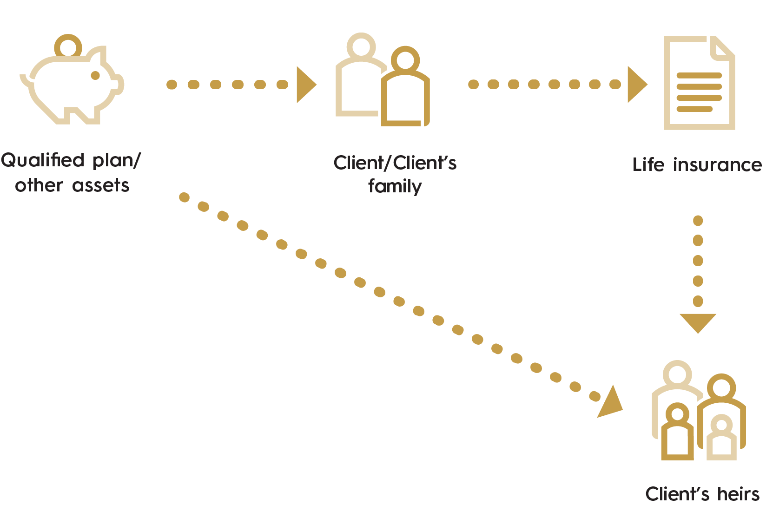
Pre-paying taxes on an inherited IRA
Opportunity
Clients spend years building their retirement
In retirement, realize they don’t need the asset to live on
Have a life insurance need*
Have multiple sources of income and assets with varying tax implications
Children are in a higher tax bracket
*If owner and insured are different, the death benefit will be paid upon death of the insured.
Notes:
Your clients have spent years building up their retirement funds. Their goal was to accumulate these assets as tax-efficiently as possible, perhaps with qualified plans like 401(k)s.
Now, they’re retired and living well enough that they only need to take RMDs from their qualified plans. They expect they will be able to leave a substantial amount of this money to an heir. Whomever receives this bequest will likely have to pay a substantial amount of taxes.
Solution: Pre-pay the beneficiaries’ taxes
If they don’t need the money, they can use the required distributions of their qualified plan to fund a life insurance policy. What you would want is a tool that will calculate forward the growth of a qualified plan and solve for a death benefit equal to the amount of taxes that would be owed at an assumed mortality age.
This strategy can make good sense, especially if any of these situations apply:
They need a life insurance death benefit to pay estate taxes when they* die
Their children are in a higher tax bracket than they are
They have multiple sources of income and assets with varying tax implications
They don’t need all of their qualified plan assets for living expenses
*If owner and insured are different, the death benefit will be paid upon death of the insured.

Slide 8
Target clients
Clients with significant qualified assets
Taking only RMD income
Want to pass their retirement assets as efficiently as possible to the next generation
Among traditional IRA–owning households in mid-2021 with a head of household aged 70 or older and taking a withdrawal in tax year 2020, 85 percent indicated their withdrawal was based on the RMD rules*
  Only 6 percent took lumps sums based on needs.
Notes:
Read slide
Read 4th bullet fully.
Among traditional IRA–owning households in mid-2021 with a head of household aged 70 or older and taking a withdrawal in tax year 2020, 85 percent indicated their withdrawal was based on the RMD rules*
Only 6 percent took lumps sums based on needs.
~ Source: Holden, Sarah, and Daniel Schrass. 2022. “The Role of IRAs in US Households’ Saving for Retirement, 2021.”
ICI RESEARCH PERSPECTIVE, JANUARY 2022 // VOL. 28, NO. 1,
Available at www.ici.org/files/2022/per28-01.pdf.

Slide 9

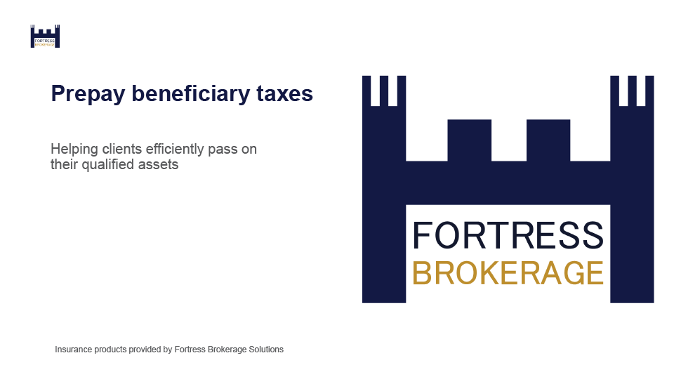
Pre-paying beneficiary taxes marketing materials
Consumer brochure – F82833-46
Consumer PowerPoint
Illustration presentation
Notes:
We’ve developed a few marketing materials to help pitch this concept to clients.
First is a client brochure called Pre-paying your beneficiary’s taxes. Form number F74093-46; available now.
If you’re working with clients primarily through remote meetings and webinars, we’ve created a client-facing PowerPoint of the exact same content. It’s essentially a PowerPoint recreation of the brochure itself. All copy is the same and presented on-screen to facilitate meeting via web presentation tools.
We developed an illustration sales presentation that can help you land the concept with clients with numbers specific to their situation. It uses the brochure as the front-end content for this illustration, and it makes a calculation for growing the qualified asset out to the age of mortality, then calculates the taxes that would be owed at that point, and solves for a face amount equal to those taxes.

Slide 10
How it works
Pre-paying beneficiary taxes https://www.fortressbrokerage.com/
Notes:
The pre-paying beneficiary taxes illustration presentation is available in our illustration system on your Fortress Brokerage Solutions professional web site.
Go to the on-screen link and log in…

Slide 11
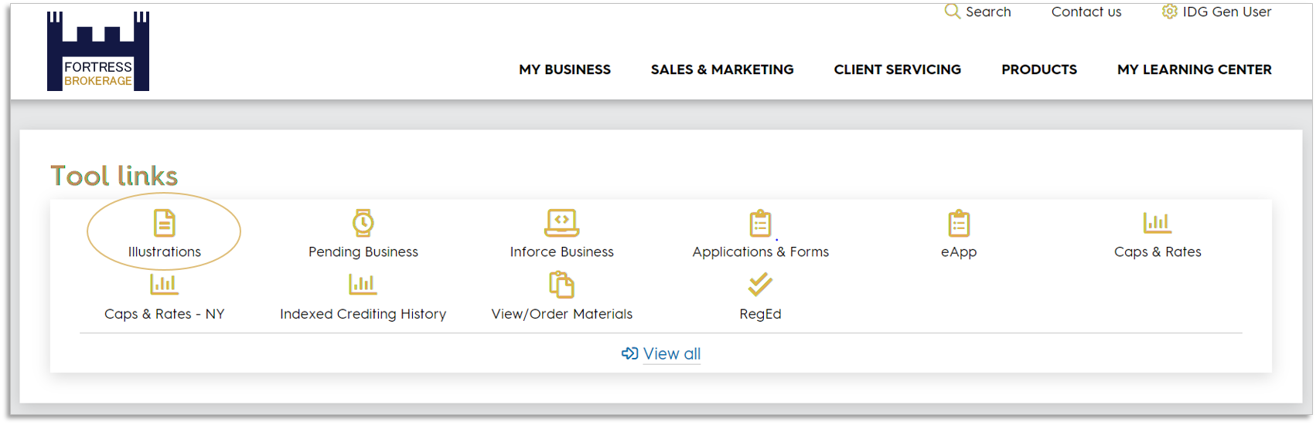
Go to our illustration system
Notes:
…and you’ll find our illustration system near the top of the page, shown circled here in the “Tool links” section.
<note to presenter: the location of this link on the page may differ depending on distribution channel. This view shows IDG general user.>

Slide 12
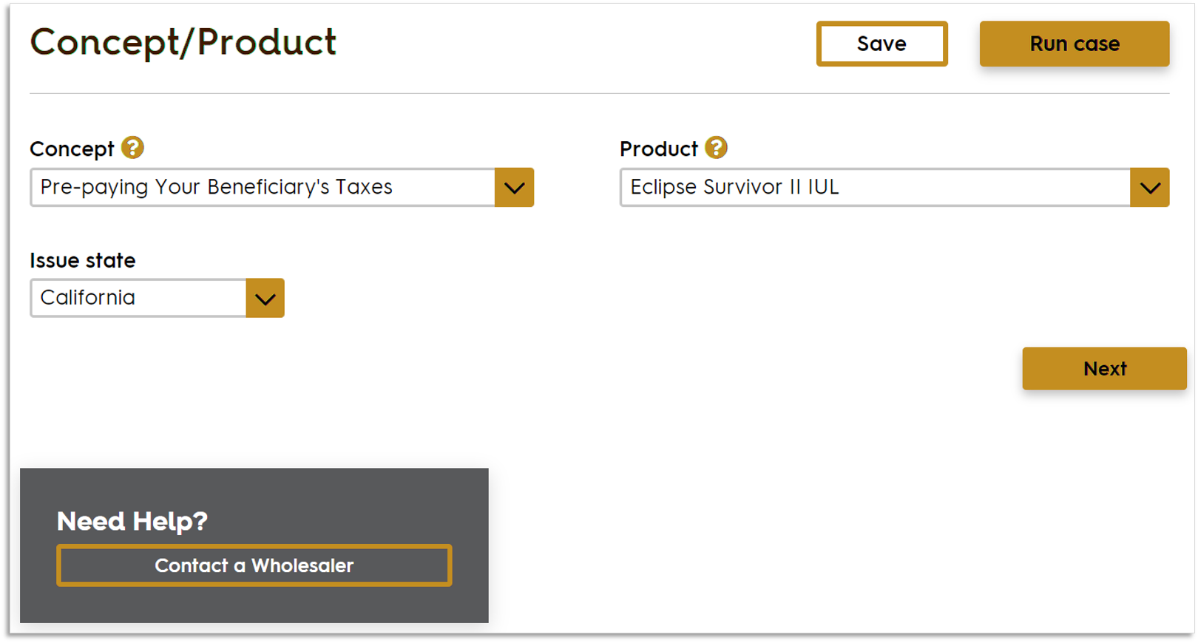
This is a hypothetical example for illustrative purposes only. Product features and availability may vary by state.
Notes:
Case ID 20894733
I’ll show you a key screen grab of the inputs for this strategy, but as it shows in the lower left here, if you get hung up just contact us.
This strategy works well with a survivorship product, so for this example we’ll use Eclipse Survivor II Indexed UL.

Slide 13
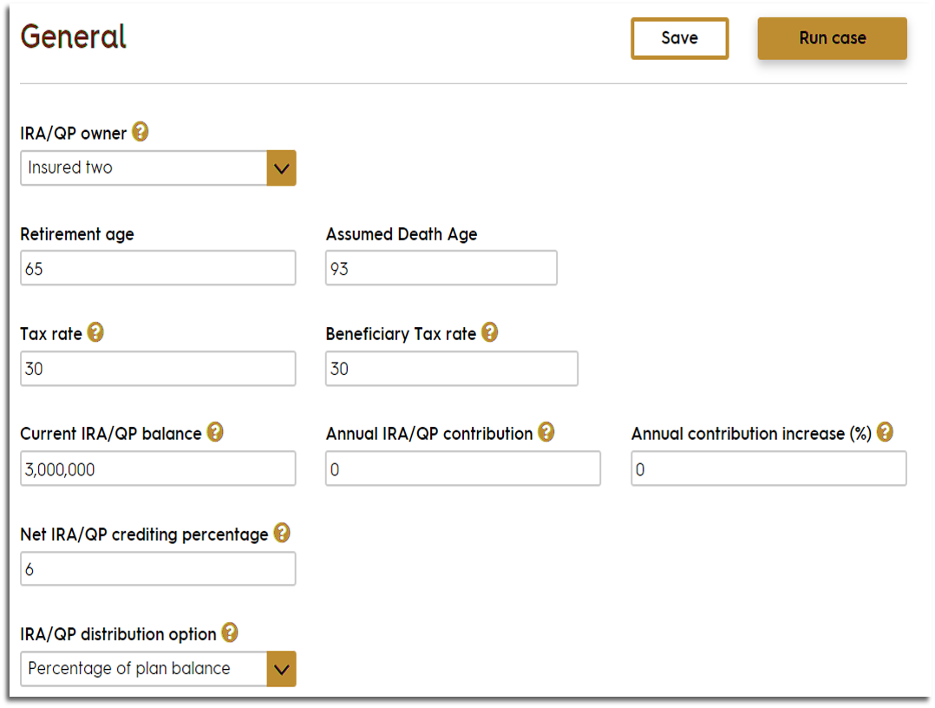
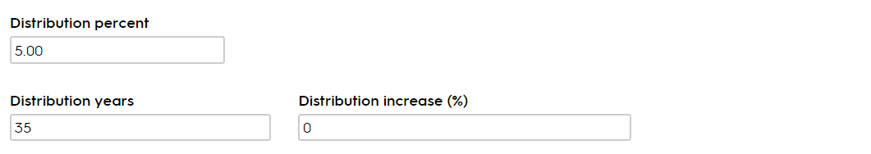
This is a hypothetical example for illustrative purposes only.
Notes:
The “General” tab is what we’ll focus on in this presentation. It allows the inputs needed for this strategy. The others are just your basic life insurance inputs.
In our example, our client is a 65-year-old female, standard non-tobacco and we’re setting the “Assumed Death Age” to 93. We have $3 million in a current IRA or other qualified plan and we’re going to show growth of that balance at a net rate of 6%.

Slide 14
The output
Notes:
After entering the information and running the case, we get a report.

Slide 15
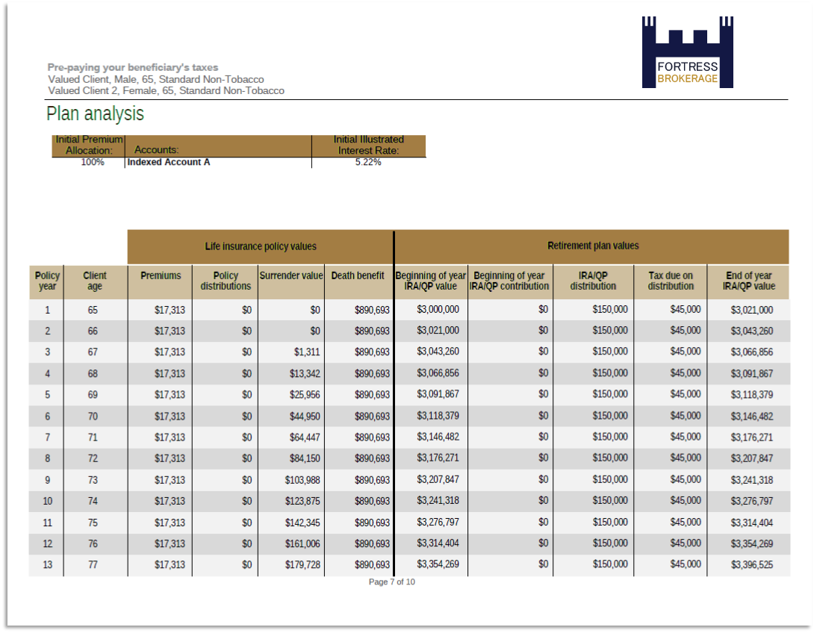
Notes:
As I noted earlier, this presentation is built with the content of the consumer brochure serving as the front-end content for this report. This is to help ensure a continuity of message, imagery, and familiarity should you use the brochure to pitch this concept to your client.
Then on page 7 we see the accumulation of the retirement account.

Slide 16
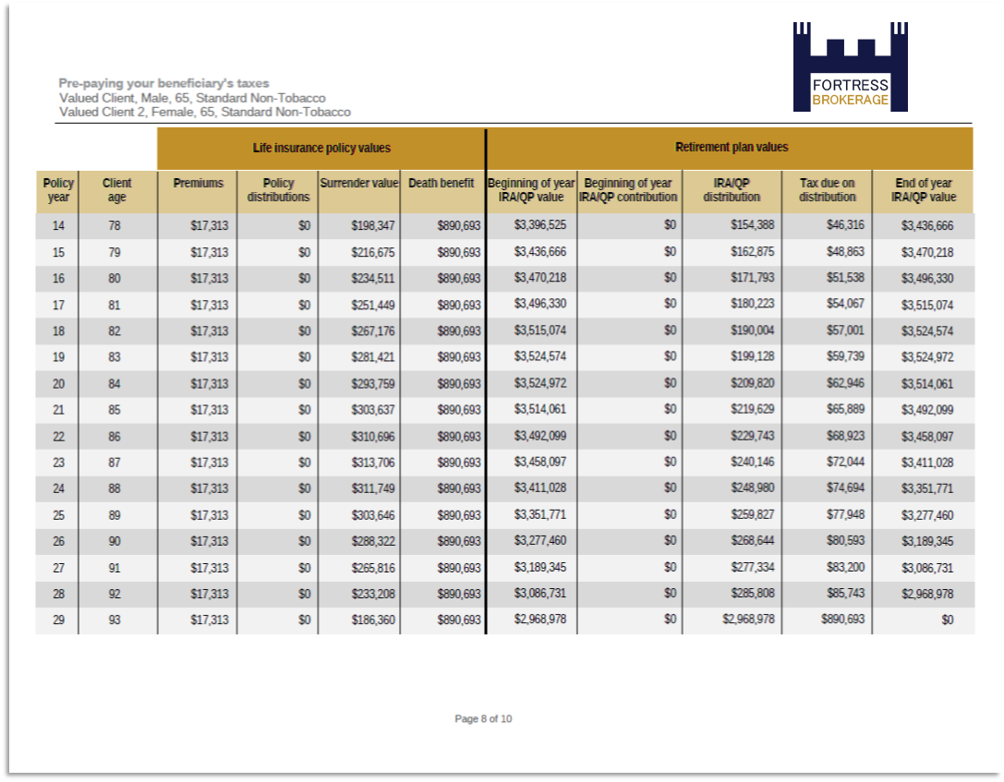
This is a hypothetical example for illustrative purposes only.
Notes:
Page [8] demonstrates that at assumed age of death, the death benefit in the policy is equal to the tax due on a distribution of $2,968,978.

Slide 17
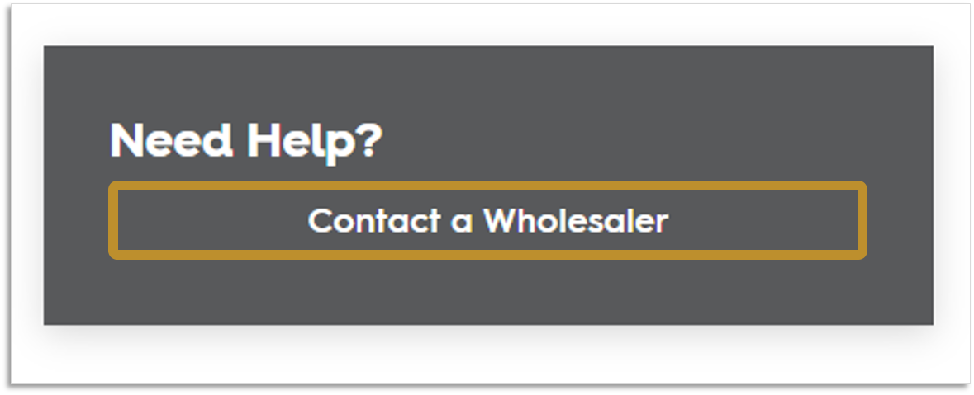
We’re here to help
Notes:
Remember, if you have trouble running these illustrations, need help with them or simply need someone to run one for you that’s what we’re here for. Just go ahead and click that button you see in our illustration system…

Slide 18
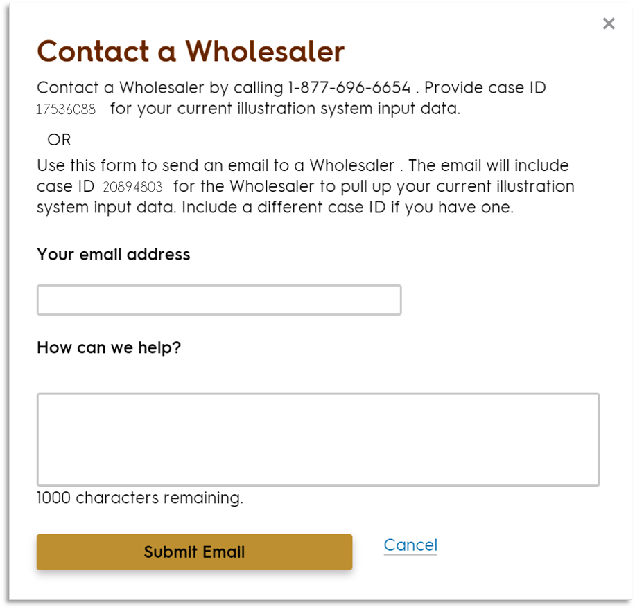
678-322-3040.
Notes:
… and this interface pops up. You can give us a call or send in a request and the case you’re working on will include the case ID.

Slide 19
Questions
Fortress Brokerage Solutions
(678)322-3040
www.fortressbrokerage.com
6190 Powers Ferry Road, Suite 505 Atlanta, GA 30339
©2022 All Rights Reserved Fortress Brokerage Solutions.
Notes:
Let’s open it up for questions…
<take questions>
<This slide has been templated to allow change to phone numbers for sales support for our brokerage general agency relationships.>

